Slide 1
Crime Record
Abdallah Divkar
Mohammad Quazi
Rojina Chemjong
Ahmad Al Bouchi

Slide 2
Entity Relationship

Slide 3
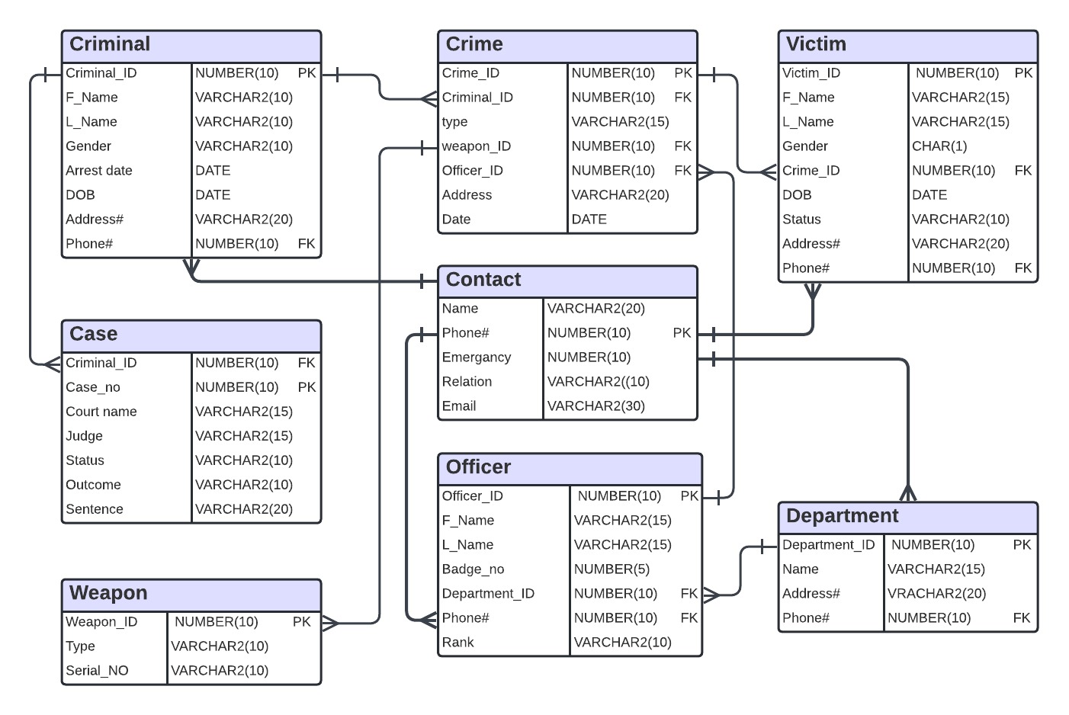
Initial ER Diagram

Slide 4
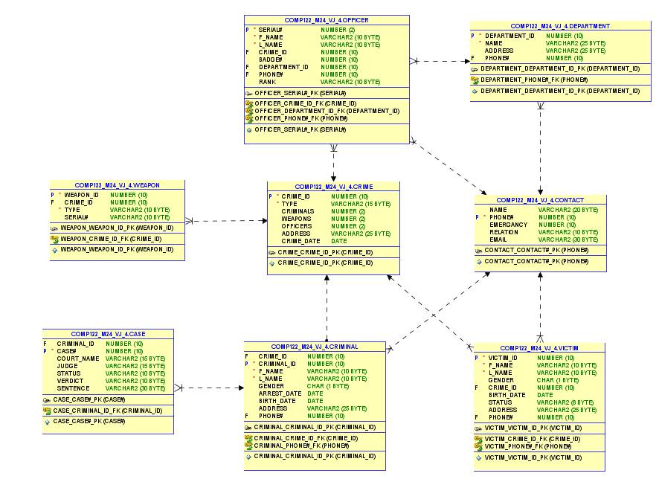
Final ER Diagram

Slide 5
Business Rules

Slide 6
RELATIONSHIPS
Each Crime has a CRIME_ID
Each Criminal has a CRIMINAL_ID
Each Officer has a BADGE#
Each department has a DEPARTMENT_ID
Each Case has a CASE#
Each Victim has a VICTIM_ID

Slide 7
Relationships
Each CRIME can have multiple CRIMINALS
Each OFFICER belongs to a DEPARTMENT
Each WEAPON is connected to a CRIME
EACH CRIMINAL / VICTIM / OFFICER / DEPARTMENT has a PHONE#

Slide 8
Relationships
The 1st 2 digits of CRIME_ID relate to the type of CRIME
11 ROBBERY
22 MURDER
33 DRUG
44 VANDALISM
55 FRAUD
66 ASSAULT

Slide 9
RELATIONSHIPS
The last 4 digits of CASE# are the same as the CRIMINAL_ID .
This relates the criminal to the case.

